Slide 1
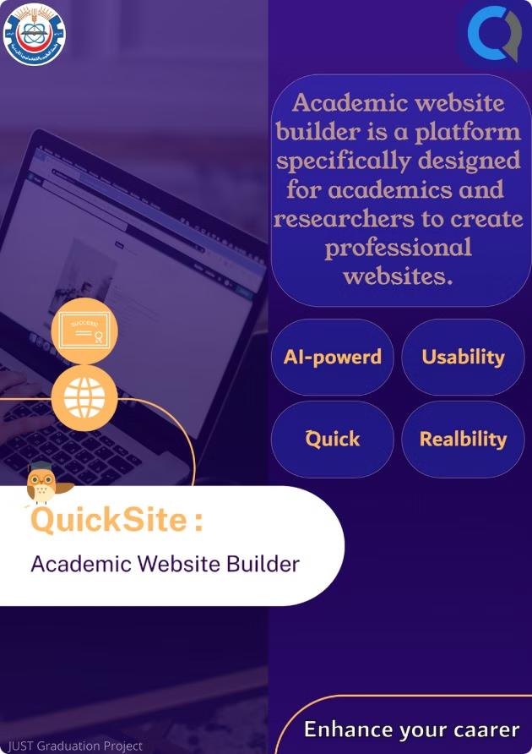

QuickSite: Academic Website Builder
QuickSite is an AI-powered platform designed to help academics create professional websites effortlessly. It automates the process of building a website, integrating publications, and managing content, allowing researchers to focus on their work.

Slide 2

Project Motivation
Time and Complexity
Limited Accessibility
Creating a professional website can be time-consuming and difficult for academics, especially those without technical skills. QuickSite aims to simplify this process.
Existing website-building tools are often too complex or rely on generic templates that lack the uniqueness academics need to showcase their individuality and achievements.

Slide 3


Problem Statement
1
Missed Opportunities
2
Manual Effort
Without an easy way to display their research, accomplishments, and personal style online, academics lose opportunities to enhance their professional reputation, connect with collaborators, and share their work widely.
Academics often spend significant time manually collecting and organizing their information from various platforms, such as Google Scholar and ORCID, to build a cohesive online presence.
3
Need for affordable solution
Many academics and researchers face budget constraints that make it difficult to create and maintain professional websites, as existing solutions often require expensive tools, software, or hiring skilled developers, limiting their ability to showcase their work effectively.

Slide 4

QuickSite's Solution
AI-Powered Design
Automated Integration
QuickSite uses AI to generate unique and customized website designs that reflect the user's academic background and preferences.
The platform automatically gathers and integrates scattered professional information from platforms like Google Scholar and ORCID into a professional website.
Affordable and User-Friendly
QuickSite provides an affordable and user-friendly solution, enabling researchers to establish a strong online presence without technical expertise or substantial financial investment.

Slide 5

Review of Related Literature
Owlstown
Wix
Limited customization, subscription costs, dependence on Google Scholar, complicated design templates, lack of AI integration.
Target audience is general-purpose, no direct support for academic publication integration, subscription costs, overwhelming interface for beginners, support AI-powered features.

Slide 6



Compare summary
Platform/
customization
Profiles integration
AI-powered
subscription
Academic specialization
features
owlstown
Wix
Edu blogs
QuickSite

Slide 7

Functional Requirements
User Requirements :
System Requirements :
Account Management
User Management
Website Generation
Platform Monitoring
Profile Integration
Analytics and Reports
Customization Options
Content Management
Publishing and Hosting
Explore Community
Notifications
Analytics and Reporting
Support and Feedback
Payment

Slide 8




User Account Management
1
Registration and Login
2
Account Recovery
3
Account Management
Users should be able to register for an account and log in securely using strong authentication mechanisms.
The platform should provide email-based password reset functionality for users who forget their credentials.
Users should be able to manage their account settings, including updating their profile information and changing their password.
Website Generation
1
Minimal Inputs
2
AI-Powered Design
3
Website Preview
Users should be able to initiate website generation by providing minimal inputs, such as their name and links to their academic profiles.
The platform should leverage AI to design websites that reflect the user's preferences and academic background.
Users should be able to preview their generated website before publishing it.
Profile Integration
1
Data Integration
2
Automatic Updates
3
Data Security
The system should integrate data from linked academic profiles, such as Google Scholar and ORCID.
Content from integrated profiles should update automatically if changes are made on the source platforms.
Sensitive user data, including academic profile links, should be encrypted and protected against breaches.

Slide 9

Customization Options
1
Theme Selection
2
Theme Customization
3
Visual Enhancements
Users should be able to select from a set of themes specifically designed for the needs of academics.
Users should be able to customize themes with their favorite colors and fonts.
Users should be able to add banners and images to make their pages visually appealing.
Content Management
1
Content Types
2
Content Organization
3
Content Editing
The platform should support the creation and maintenance of different types of academic content, including publications, projects, people, courses, news, custom pages, contact info, CV, and social links.
Users should be able to organize their content into categories and subcategories for easy navigation.
Users should be able to edit and update their content easily.

Slide 10

Non-Functional Requirements
Performance
Scalability
The platform should generate websites within 10 seconds after the user provides necessary inputs. Integration with academic profiles should sync updates within 24 hours of changes being detected.
The system should handle up to 500 simultaneous user requests without degradation in performance.
Availability
Usability
The platform should be operational 24/7, with scheduled maintenance causing minimal downtime.
The interface should be intuitive, allowing users to generate a website with minimal technical knowledge. The system should support both Arabic and English languages.
Reliability
Security
The platform should ensure consistent integration of data from external academic profiles. A recovery mechanism should restore user data in case of system failure.
Sensitive user data, including academic profile links, should be encrypted and protected against breaches. The platform should comply with data protection laws such as GDPR.
Maintainability
Compatibility
The platform should have modular code and clear documentation for easy updates and fixes.
The platform should function seamlessly on major web browsers, including Chrome, Firefox, and Edge.

Slide 11

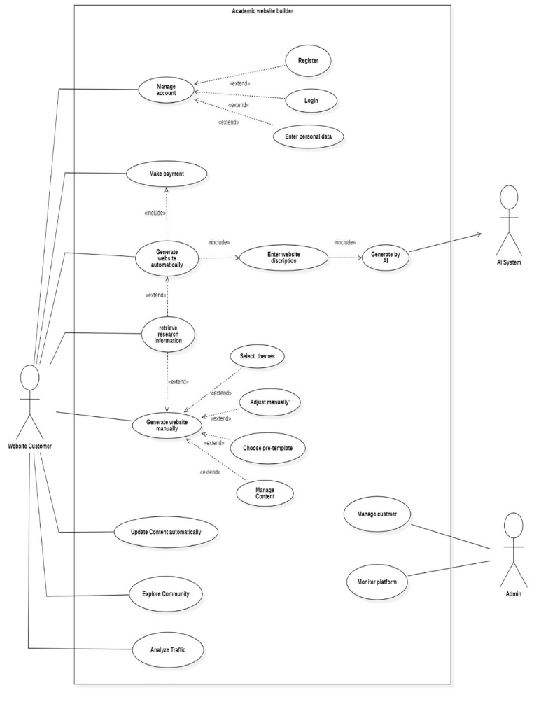
Use Case Digram
Specify the context of the system and to capture the requirements of the system.

Slide 12

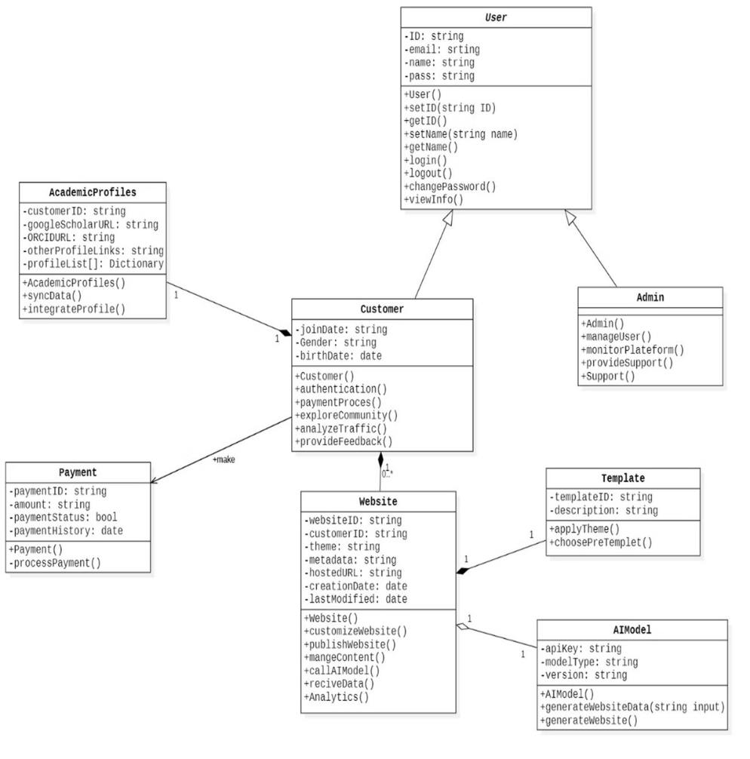
UML Class Diagram
Ddescribe the structure of a system by showing the system classes, their attributes, methods.

Slide 13
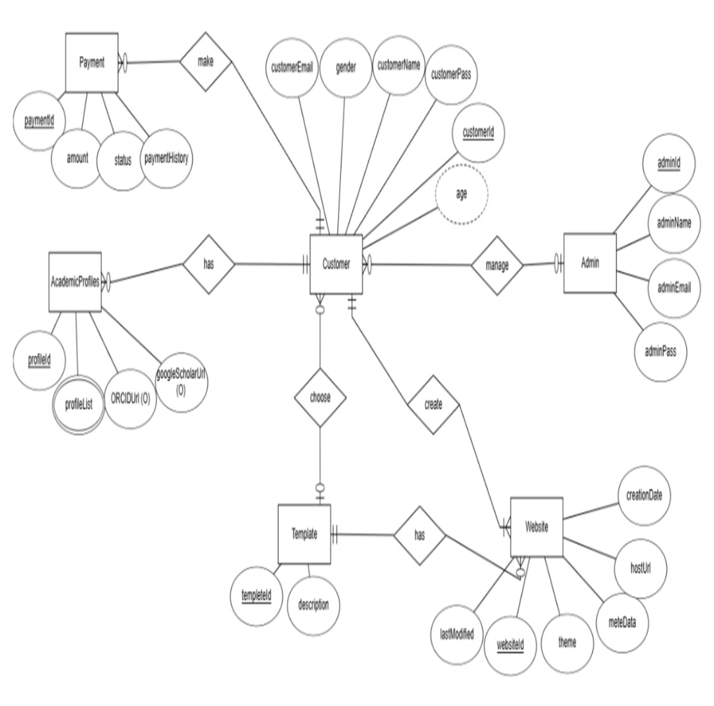
ER Diagram
Diagram use in database design and designing relational databases

Slide 14
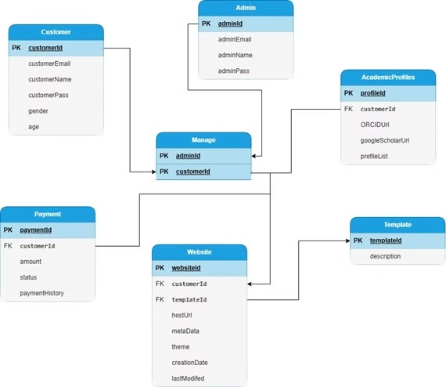

Database Schema
The skeleton structure that represents the logical view of the complete database.

Slide 15

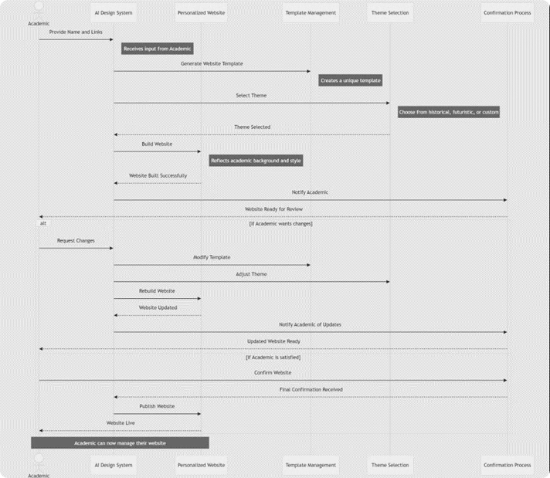
Sequence diagram
The interactions between objects or components in a system in a sequential order.

Slide 16

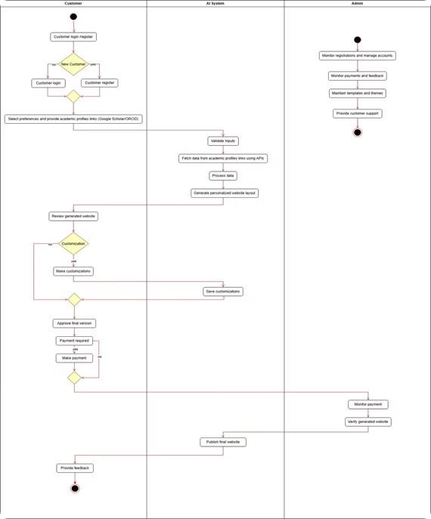
activity diagram
Represent the workflow or sequence of activities in a system. It focuses on the flow of control or data from one activity to another,

Slide 17


Analysis of survey answers
75%
72%
1/5
with no Web Dev experience
want to build a personal wabsite
hire programmer
1/4
63%
72%
use pre-template tools
want to publish their Research
intrest in automatic integration

Slide 18
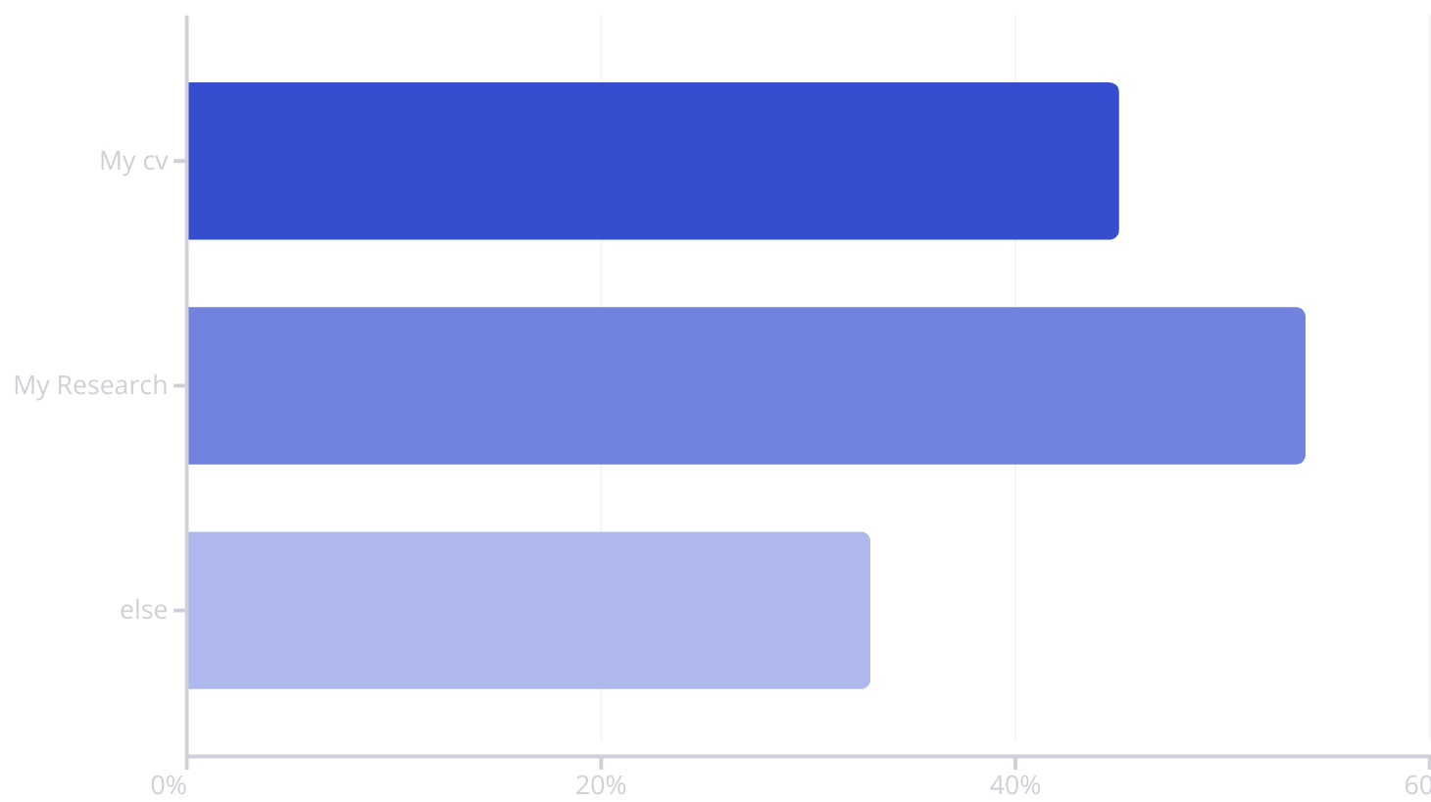
What do you want to show in your personal website:

Slide 19




Conclusion
1
Simplified Website Creation
2
Time Savings
3
Professional Results
QuickSite successfully provides a solution for academics who struggle with creating a professional online presence. The platform makes it easy for users to generate personalized websites that showcase their work and achievements.

Slide 20


Thank you for listening
Any questions?

